Slide 1
Xi Wang. A20337032.
CS542 Project report
Professor: Dr. Michael Y. Choi
Nov, 2015.

Slide 2
Link-State Routing Protocol
Finding the shortest way to pass data.
Routers all connected in the network topology.
Each router has the info of routers which connect to them directly (who connect to them and distance).
Each router has a connection table.

Slide 3
Design Of The Program
Driver class: Interactive interface, input instructions and wrong input control.
Router class: data structure of router
ConTable class: Building the connection table, recording the source router.
TopologyMatrix class: Building the topology matrix, shortest path algorithm implemented, recording path info.

Slide 4
Description of algorithm
1.Init source router in set S, and rest of routers in set U. Init the path and distance info.
2.Find nearest router to the source router according to distance info. Put it into set S, remove it from set U.
3.Update the path info and distance info.
4. Run from step 2 util all routers were traversed.

Slide 5
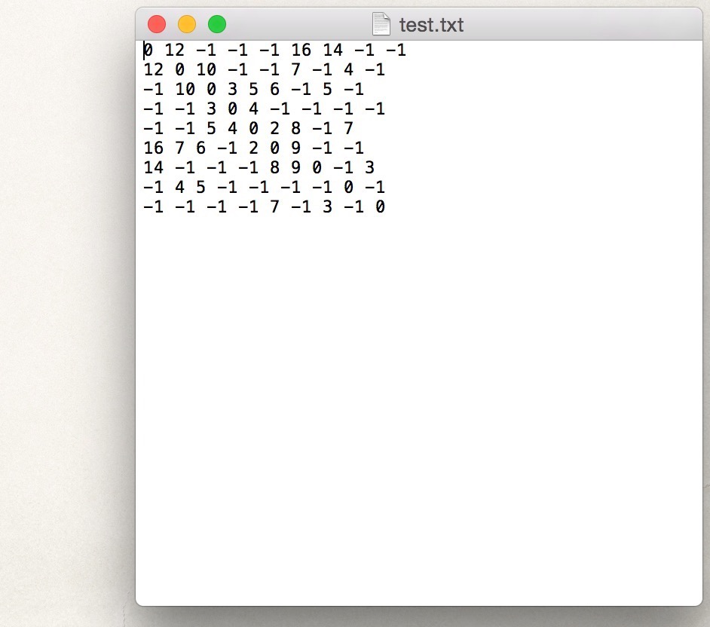

Test report
Test Matrix:
8
4
5
10
2
3
12
3
7
6
1
16
6
5
4
9
2
14
4
7
5
8
3
7
9

Slide 6
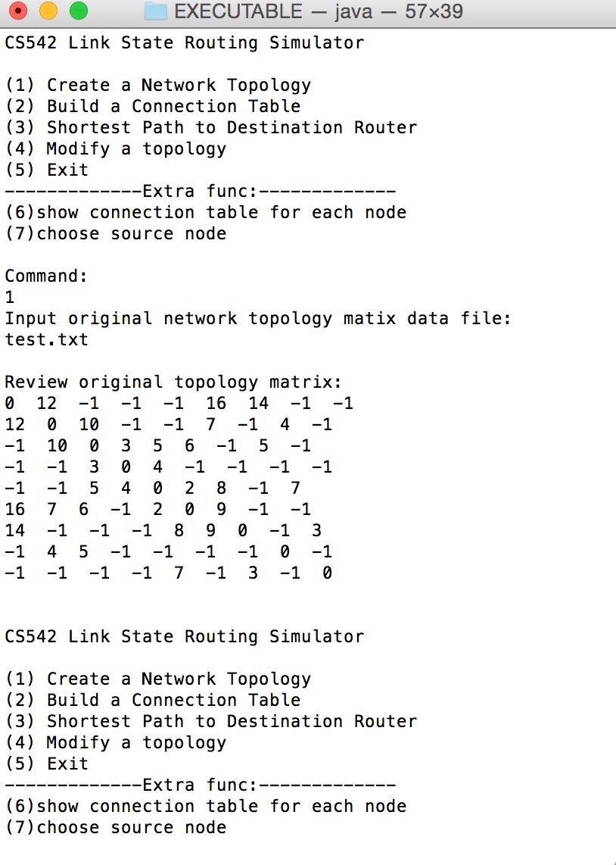
Test report
8
4
5
10
2
3
12
3
7
6
1
16
6
5
4
9
2
14
4
7
5
8
3
7
9

Slide 7
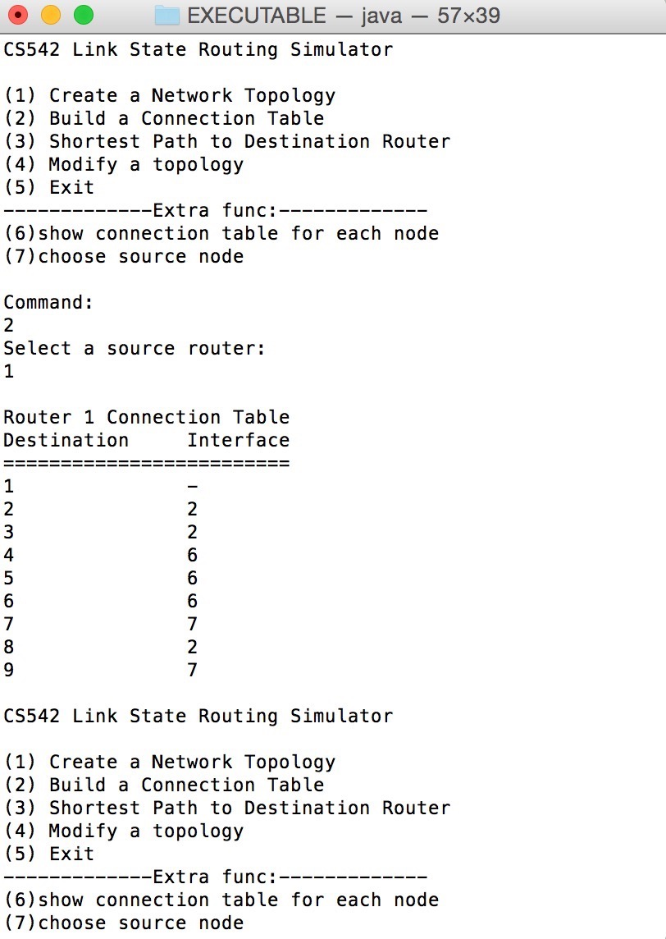
Test report
8
4
5
10
2
3
12
3
7
6
1
16
6
5
4
9
2
14
4
7
5
8
3
7
9

Slide 8
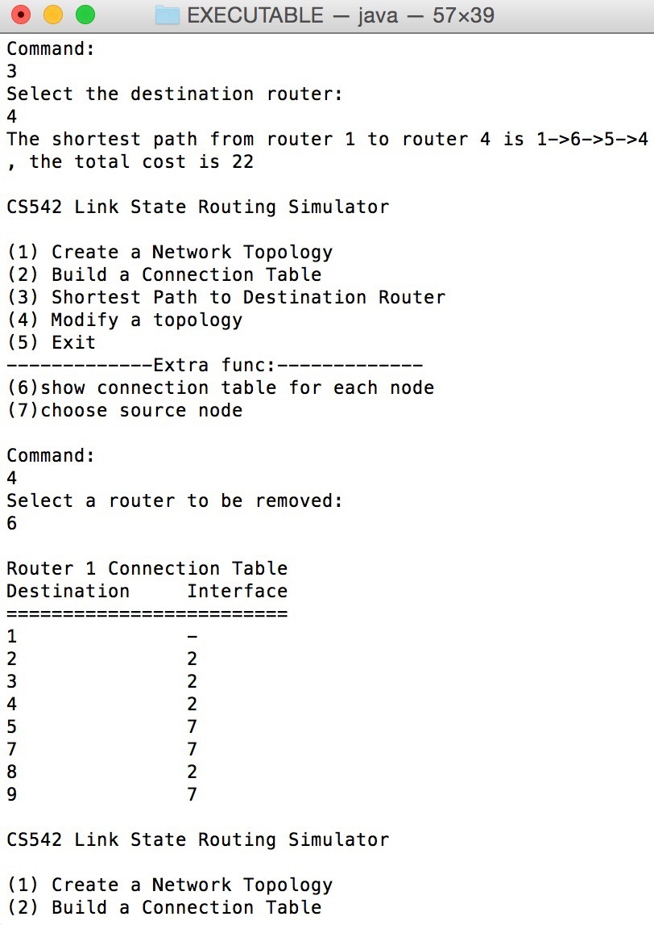
Test report
8
4
5
10
2
3
12
3
7
6
1
16
6
5
4
9
2
14
4
7
5
8
3
7
9

Slide 9
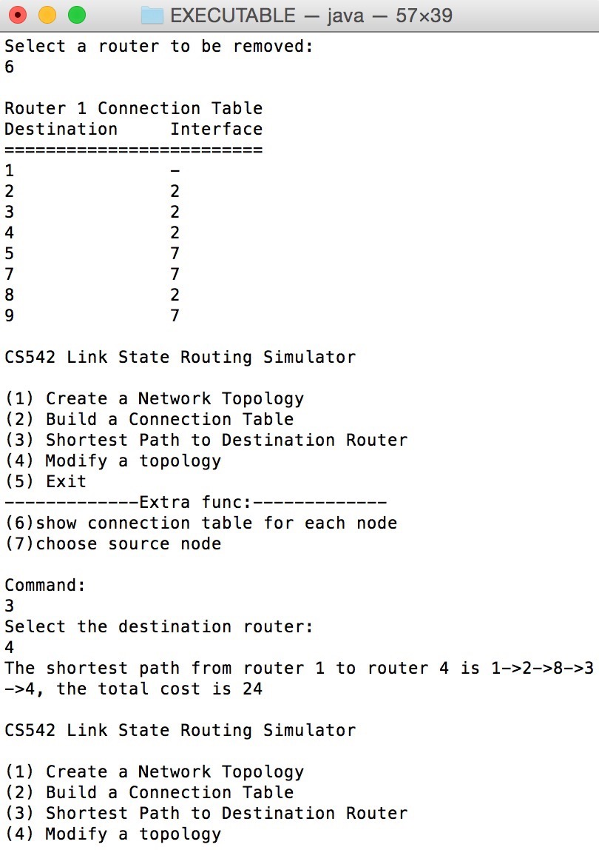
Test report
8
4
5
10
2
3
12
3
7
6
1
16
6
5
4
9
2
14
4
7
5
8
3
7
9

Slide 10
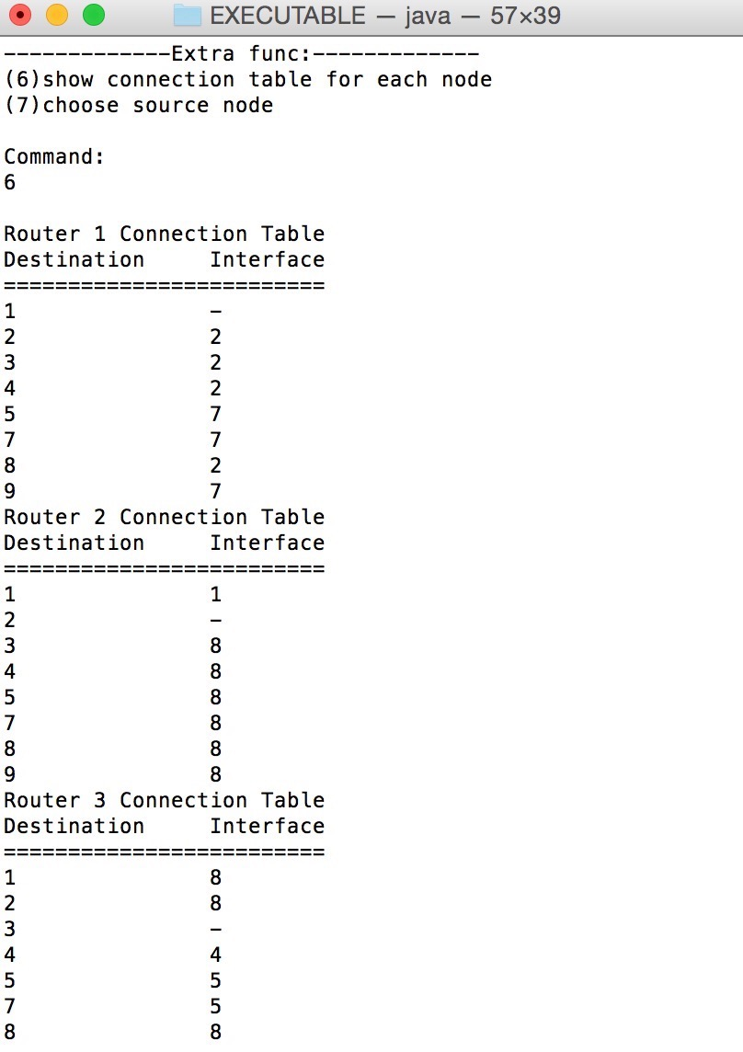
Test report
8
4
5
10
2
3
12
3
7
6
1
16
6
5
4
9
2
14
4
7
5
8
3
7
9

Slide 11
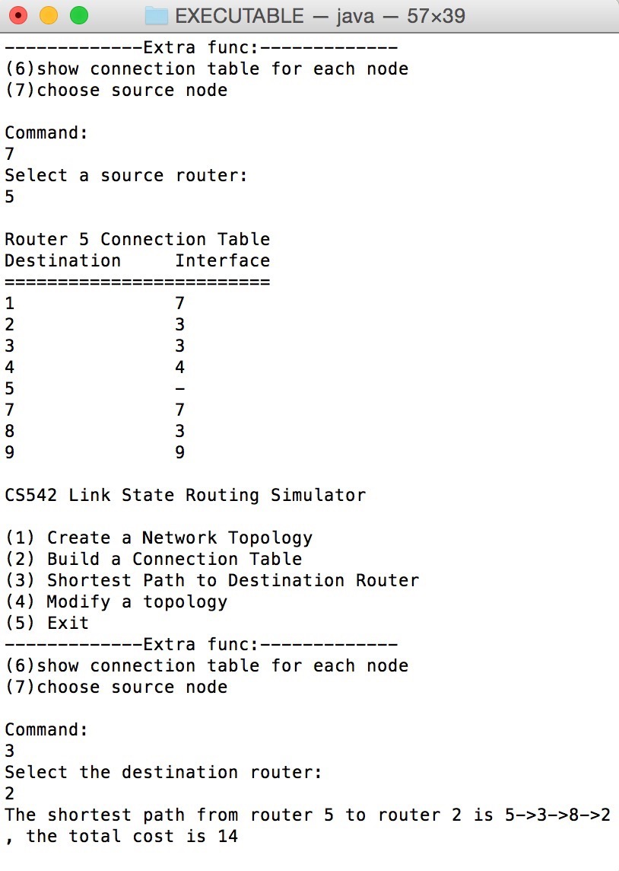
Test report
8
4
5
10
2
3
12
3
7
6
1
16
6
5
4
9
2
14
4
7
5
8
3
7
9

Slide 12
“That’s it, have a good day.”
–Xi Wang

